Slide 1
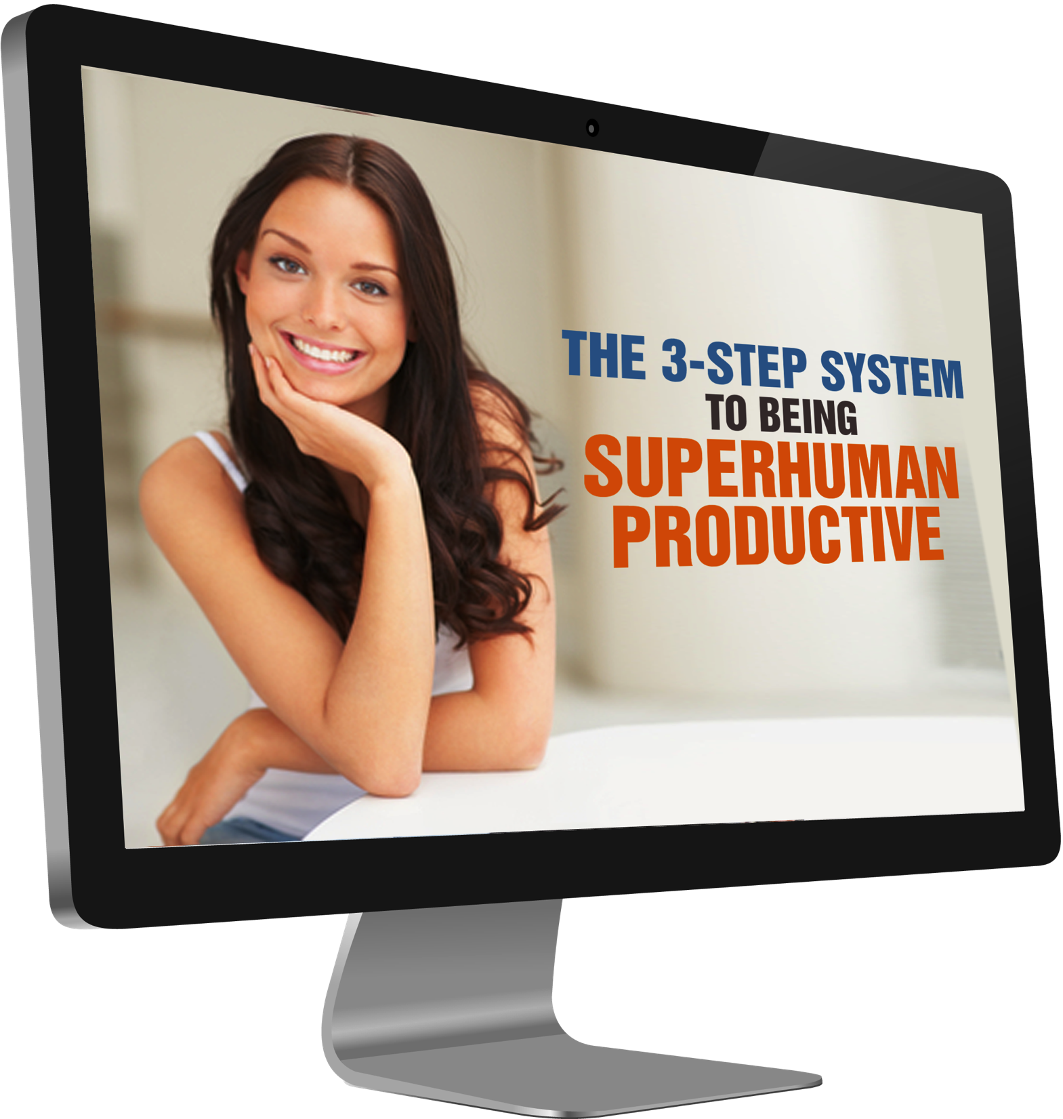
Notes:
In today’s workshop were going to cover (read slide)

Slide 2
The ONE Strategy that Will Triple Your Productivity at
Home + Work
Notes:
This 3-step system includes (read slide)

Slide 3

Heidi DeCoux
ClearSimpleLiving.com
ClearSimpleMarketing.com

Slide 4
The 3-Step System to Being Superhuman Productive

Slide 5
Step #1:
Hyper Focus

Slide 6
The Hyper Focus Technique
Set a Timer
Shut Everything Down
Hyper Focus

Slide 7
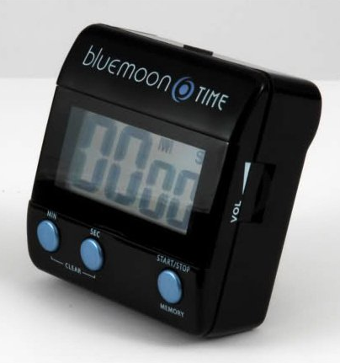

Slide 8
If you struggle with computer distractions:
For Mac – GetConcentrating.com
For PC – Temptation Blocker by WeBjillion.com

Slide 9
If you struggle with people distractions:
Shut your door
Put a sign on it
Train your family/staff

Slide 10
The ONE Strategy that Can Triple Your Productivity at
Home + Work
Notes:
Next I’m sharing with you the ONE strategy that can triple your productivity at home and work – and it’s step 2 of our 3-step system.

Slide 11
Step #2:
Set Up Systems that Support You

Slide 12
Three Examples of Systems I Use in My Businesses and Life

Slide 13


Slide 14
System #1
Paper & Files

Slide 15
Get clear on which papers you actually need to keep, how long you need to keep them and which ones you can shred/recycle

Slide 16

Get a Free
Special Report at: www.ClearSimpleLiving.com

Slide 17
Set up an efficient system for your papers and files

Slide 18
Your system needs to include a protocol for handling incoming papers, receipts, and mail.

Slide 19
Dedicated Space:
Recycle Bin
Paper Shredder
Inbox Tray
Active File System
Business Card Tray

Slide 20


Slide 21

Keeping Everything in the Cloud
Allows You To..
Access it from Anywhere
Easily Find What You Need FAST
Reduce or Eliminate Paper Clutter
Notes:
Most people aren’t able to get to 100% paperless, but these days you can get really close. {read slide} My company is virtual company in part because I’m a tech geek and minimilist and I dislike dealing with paper and I like having everything available to me at my fingertips – I want my world to be accessible on my Mac Book Air and SmartPhone. This makes it possible for me to travel an average of 100 days out of the year. By living in the cloud I am able to work from anywhere with Internet, and so is my entire staff which is critical to our business model. Being a virtual cloud-based company makes it possible for us to service small businesses on a shoe-string budget. Essentially we are a hybrid of a traditional agency and a virtual assistant service. A traditional agency is going to offer you full-service support and for doing so they are going to charge a minimum of $2,000 down plus a monthly retainer. A virtual assistant service are usually hourly and very affordable but they are simply order takers. They can’t give you strategy and support – they need you to already have that figured out and simply place an order with them then they deliver the order and you pay for the hours they spent implementing the plan you gave to them. We charge slightly higher than a VA service, but MUCH lower than a traditional agency with no minimums or monthly retainers. You may not have the type of business or life that requires you to keep everything in the cloud – BUT I promise that if you keep most of your life and business in the cloud you will be dramatically more efficient and less stressed out – even if you have a bricks and mortar business or you simply have a 9-5 day job. Eliminating the paper in your life, being able to access pretty much everything virtually, and setting up automated systems frees up your time and your head space. In my SYS program I show you all of the cloud-based tools we use and how we use them. Right now I’m going to tell you about one of them…

Slide 22
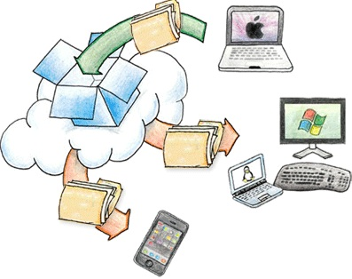
Dropbox http://db.tt/X6FVFL5
(free account)

Slide 23
Notes:
For the backstage pass tour of all of the cloud-based tools I use and how I use them – get the SYS program.

Slide 24
System #2
Having an SOP for EVERYTHING

Slide 25
SOP’s =
Standard
Operating
Procedures
Notes:
Our mission at Clear Simple Marketing.com is to deliver consistently great services to our clients as efficiently as possible so that we can charge the client as little for the service as possible and still have a profit margin. To do this, we have an SOP for EVERY SINGLE service we deliver. It also makes it possible to have freelancers help us out from time to time when someone is out sick or we have an overflow of work.

Slide 26
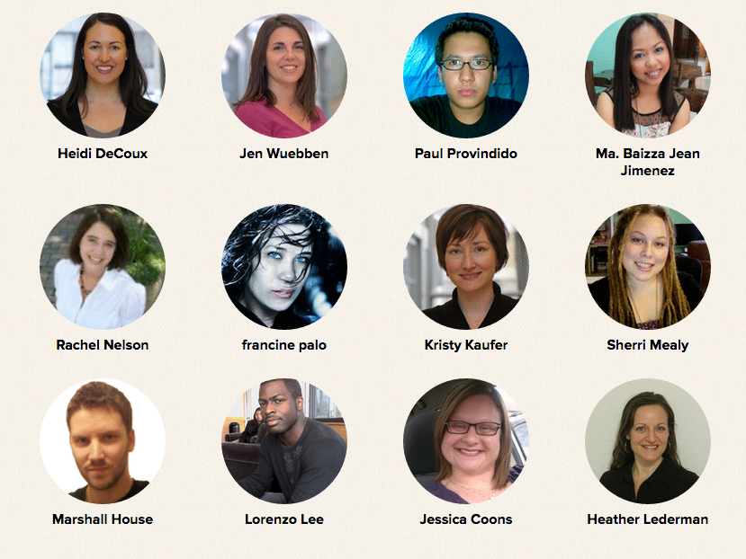

Slide 27
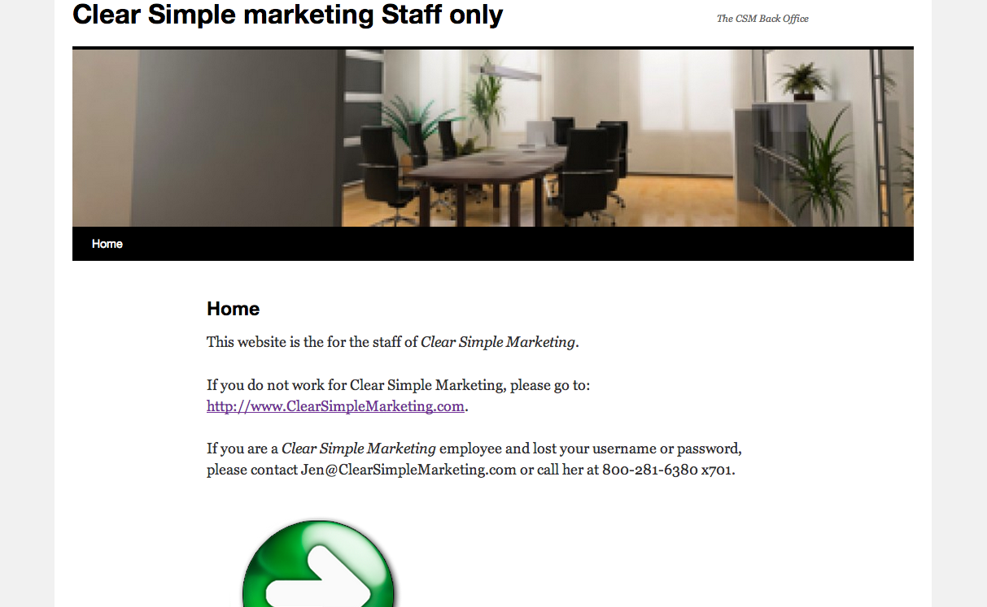

Slide 28
System #3
Setting & Achieving GOALS

Slide 29
3-Steps to Getting Anything You Want

Slide 30
STEP #1:
Decide where you want to be at the end of the year. Compose a year-end vision of your life and business, and include specific goals in your vision.

Slide 31
STEP #2:
Map out what you need to accomplish THIS quarter in order to move your business/life one-fourth of the way towards your vision. Repeat at the beginning of each quarter, moving closer to your vision.

Slide 32
STEP #3:
Create a list of specific action steps that you need to take THIS month. Schedule time in your calendar to complete your action steps this month. Repeat at the beginning of each month.

Slide 33
I recommend planning only one quarter and one month at a time because soooo much changes.

Slide 34
Some things won’t go as well as planned and you’ll be presented with new opportunities that are not yet on your radar. Have a year-end vision, but break it down in month-by-month action steps.

Slide 35
The CRITICAL component to these 3-steps is to SCHEDULE time to complete your action steps.

Slide 36
The Biggest Mistake I Made Last Year and How I Fixed it

Slide 37
Saying “Yes” To Often

Slide 38
Is it profitable?
Is it fun?
Are we EXCELLENT at delivering it?

Slide 39
System #3:
Delegate Effectively

Slide 40
Get Over the Money!

Slide 41
What Revenue Generating Activities Can You Do During the Time You Freed Up?

Slide 42
Only Delegate Things That Are Under Control

Slide 43
Delegation requires Duplicatable Systems

Slide 44


Slide 45


Slide 46


Slide 47
Get Creative!

Slide 48


Slide 49
7 BIG Time Wasters:
1. Allowing chaos to be the norm
2. Keeping everything in your head
3. Not having systems set up
4. Waiting to long to hire help
5. Not delegating or doing it ineffectively

Slide 50
7 BIG Time Wasters:
6. Staying in all the details or jumping out too fast
7. Not backing up critical people in your business

Slide 51
Notes:
If you want the backstage pass tour of my life and businesses to see all of the systems I have in place, get access to checklists and protocols, then purchase the Systematize Your Life and Business digital program by clicking on the link below – which will give you all of the details about it. Once you purchase it, you’ll get instant access to your backstage pass tour. You will get lifetime access, so you can go back and reference any of the materials anytime, plus I will update the program a couple times a year and you’ll get free access to those updates. Right now this program is available for only $47. Click the link below for details and to grab your backstage pass tour!

Slide 52


Slide 53
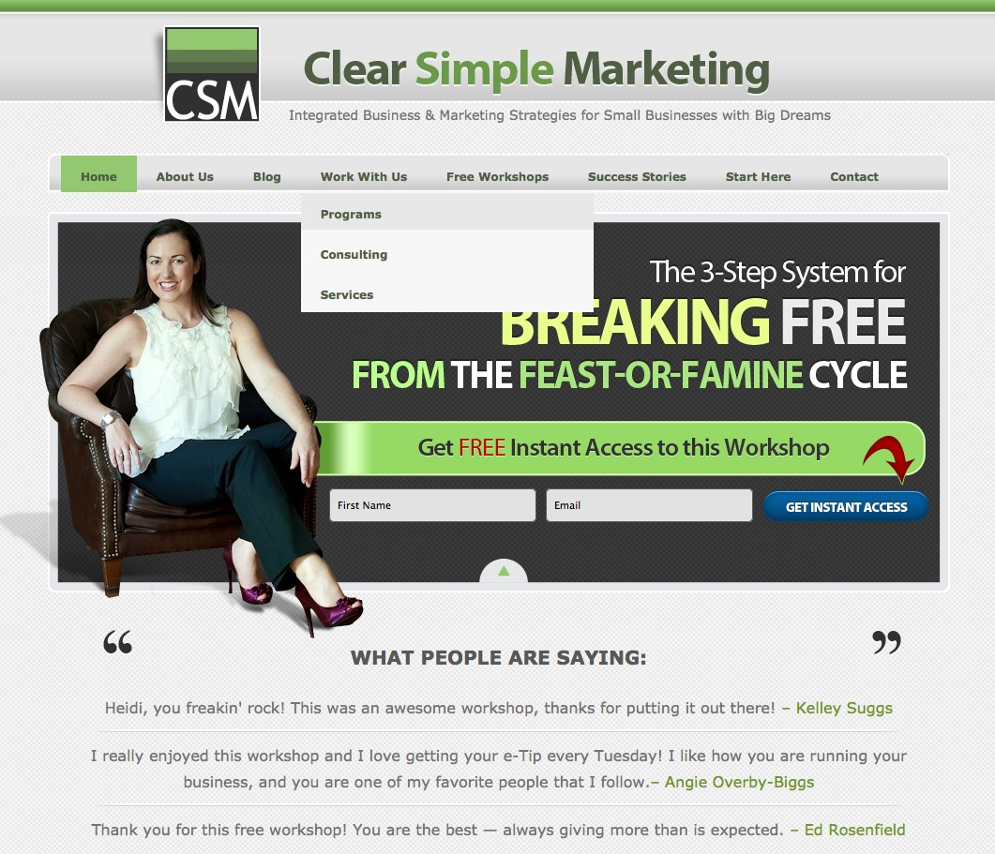

Slide 55
Q&A Time!

